Slide 1
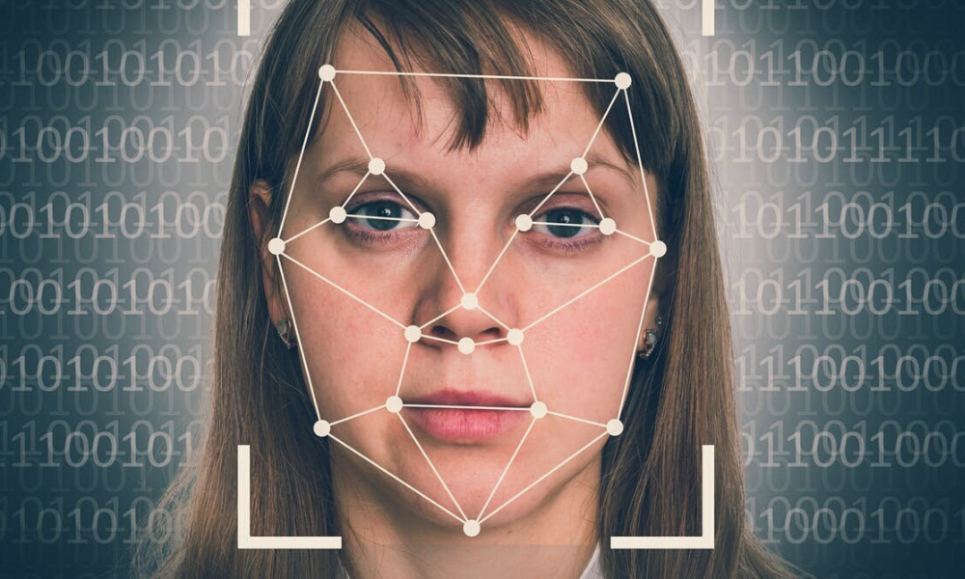
Deepfake Detection

Slide 2

Project Team:
Ahmed Maher Gomaa Eraqy
Aliaa El-Sayed Mohamed Ahmed
Kariman Alaa El-Din El-Sayed Ibrahim
Marwa Ahmed Abdo Mohamed
Mayar Boghdady Ahmed Omar
Shrouq Saber Mohamed Salem
.
Under Supervision of
Dr. Tamer Ahmed Abassy

Slide 3
Agenda
Problem Definition
Project Idea
Deepfake Generation
Deepfake Detection
Methodology
Testing
Survey
Existing Solutions
Future Work

Slide 4
Problem Definition

Slide 5
Due to the spread of social media and its great impact on our lives, as well as the development of technology that we have reached now, it has become easy for anyone to make a fake photo or video for anyone, in addition to publishing it on a large scale, which leads to harming them and exposing their lives to problems and hurt their status in society, it may be sometimes leads to suicide.
This problem was not only exposed to the general public, but also exposed to many important or famous personalities such as US President Barack Obama and actor Tom Cruise.
So, we suggested that we help people who are exposed to this problem and make an application that helps them know whether this image or video is real or fake. This will help our societies eliminate these harmful models of people.

Slide 6
Project Idea

Slide 7
The idea of ​​the project is to detect fake images and videos, so the user logs in to the application and uploads the image or video that he wants to detect whether it is real or fake.

Slide 8
Deepfake Generation

Slide 9
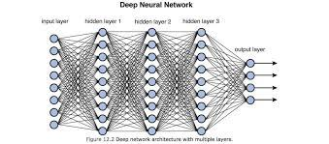
Deepfake is based on the “Deep Learning” so, what is deep learning? Deep learning: is a subset of machine learning, which is essentially a neural network with three or more layers. These neural networks attempt to simulate the behavior of the human brain-albeit far from matching its ability-allowing it to “learn” from large amounts of data. And the approach used on deepfakes is “GANs” so, What is GANs?

Slide 10
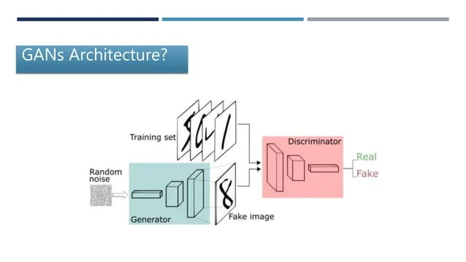
Generative adversarial networks: they create new data instances that resemble your training data It consists of two networks play an adversarial game against each other 1- The Generator model that we train to generate new examples. 2- The Discriminator model that tries to classify examples as either real or fake (generated). In GANs the two models are trained until the discriminator model is fooled about half the time, meaning the generator model is generating sensible examples.

Slide 11
Deepfake Detection

Slide 12
Visual artefacts‐based methods In most existing deepfake methods, the generated face has to be blended into an existing background image, causing exist intrinsic image discrepancies on the blending boundaries.
There are main visualartefacts: - Face warping artefacts - Blending boundary - Head pose inconsistency - Teeth: the line of the teeth is not clear and looks “cartoon” unnatural.

Slide 13
Spatial and Temporal Features Analysis Most current deepfake detection methods only use a single video frames. In fact, video manipulation can be carried out on multiple frame-level features. Recently, many researches have shown that analyzing the temporal sequence between frames can successfully help to discriminate the real video or the fake one. The model first employs a convolutional neural network (CNN) for frame features extraction. Afterwards, these features are passed to LSTM layer to analysis a temporal sequence for face manipulation between frames.

Slide 14
Camera‐fingerprints‐based methods Camera fingerprints are a kind of noise with very weak energy, which plays an important role in forensic fields, especially source identification tasks. Camera fingerprints have been proved to be effective in deepfake detection tasks. However, accurate estimation of camera fingerprints requires many images captured by different types of cameras. Thus, there would be a decrease in accuracy when detecting images captured by unknown cameras. On the other hand, camera fingerprint‐based methods are not robust to simple image postprocessing such as compression, noise and blur. Since GAN images are generated model.

Slide 15
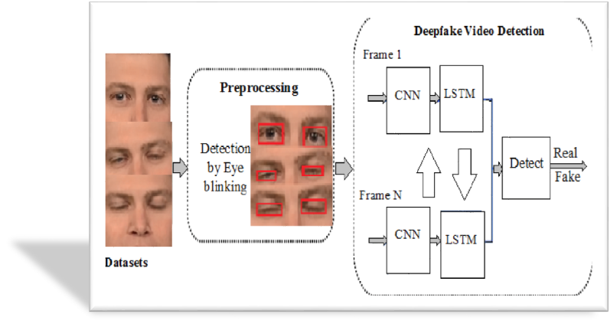
Biological-Signals-based Method There are two approaches based on biological signals:
1. Heart Rate 2. Eye Blinking

Slide 16
General network-based method In this method, face images extracted from the detected video are used to train the detection network. Then, the trained network is applied to make predictions for all frames of this video. The predictions are finally calculated by averaging or voting strategy. Consequently, the detection accuracy is highly dependent on the neural networks, without the need to exploit specific distinguishable features. There are two types of this method: -Transfer learning-based methods -Detection approaches based on specially designed networks.

Slide 17
Methodology

Slide 18
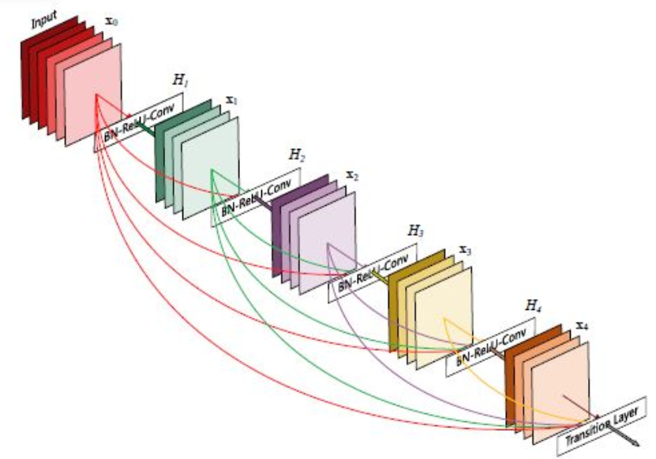
Image Detection
We use 140k Real and Fake Faces dataset for image detection
Densenet121 Model
In a Densenet architecture, each layer is
connected directly with every other layer,
hence the name Densely Connected
Convolutional Network. For 'L' layers,
there are L(L+1)/2 direct connections
It consists of 1 7*7 convolution layers, 58 3*3 convolution layers, 61 1*1 convolution layers, 4 AvgPool layers, 1 Fully Connected layer

Slide 19
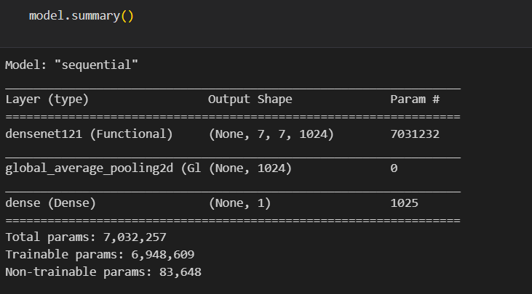
Image Detection
We use this model for
image detection.
The size of input image
to model is 224*224

Slide 20
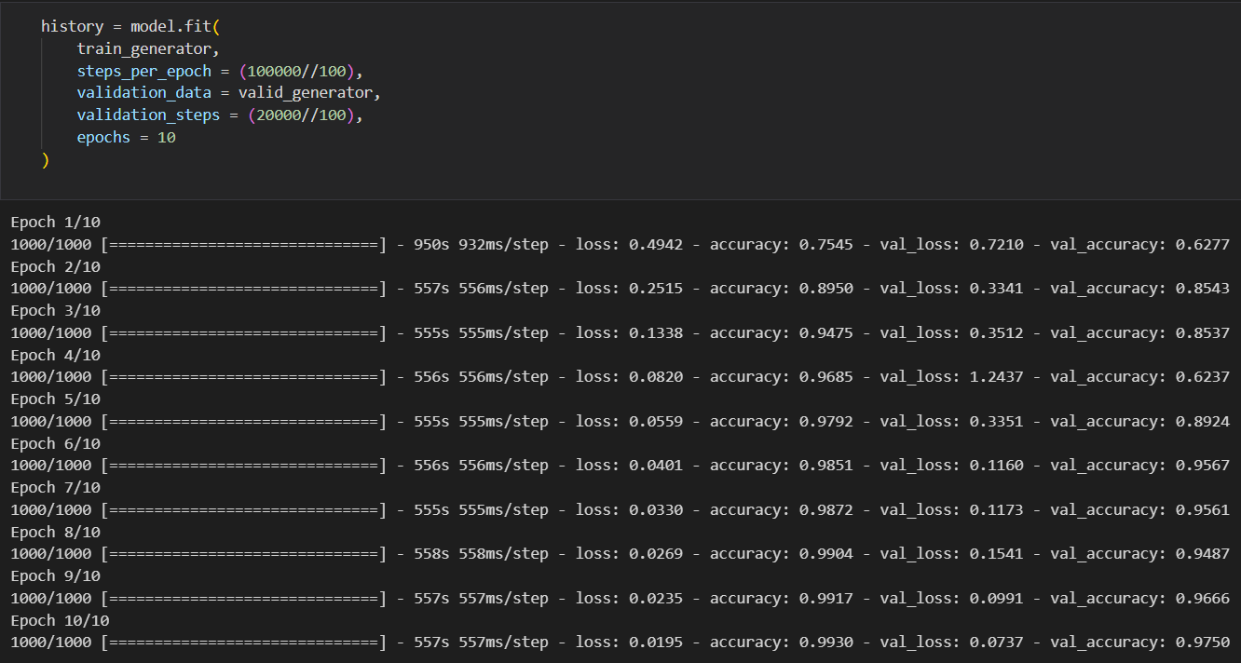
Image Detection
We train this model
within10 epochs.
The final accuracy
is 99% for training and
97.5% for validation.

Slide 21
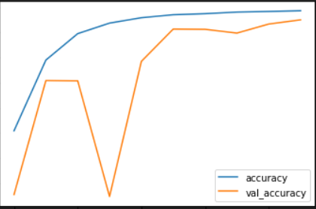
Image Detection

Slide 22
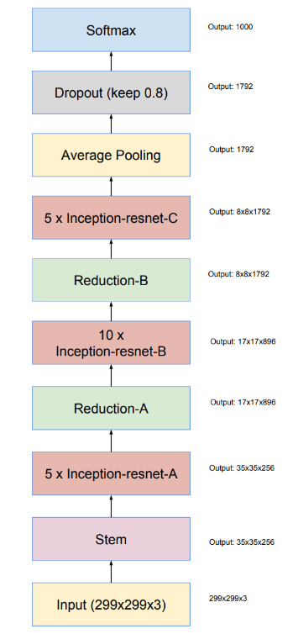
Video Detection
We use FaceForensics++ dataset for video detection
We use 900 real videos and 900 fake videos from this dataset.
InceptionResnetV2 Model
It’s a convolutional neural network that is trained on more than
a million images from the ImageNet database. The network is
164 layers deep and can classify images into 1000 object
categories, such as keyboard, mouse, pencil, and many animals.
As a result, the network has learned rich feature representations
for a wide range of images. The network has an image input size
of 299-by-299.

Slide 23
Video Detection
Preprocessing of video:
- CV2: is used to read and analyze video files and convert them into processable
arrays, resizing images size to 128 * 128 images size & save the processed
images after preprocessing.
- dlib: is used to detect faces in images.

Slide 24
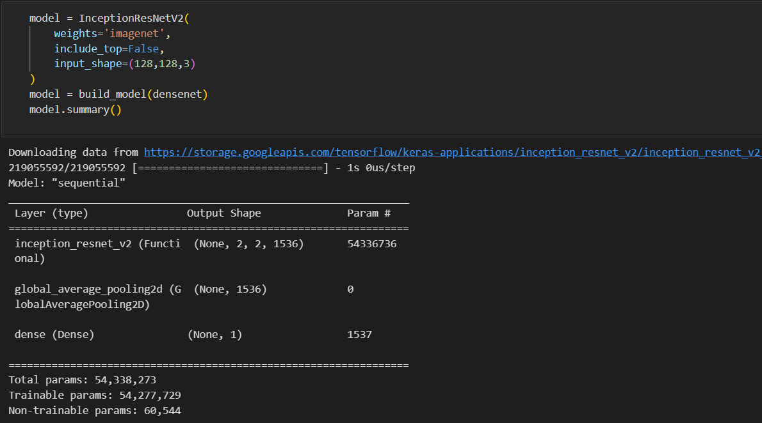
Video Detection
We use InceptionResnet model for
video processing, and we resize
the input image to 128*128 image size,
it classifies images into 2 categories
(Real or Fake) instead of 1000 categories.

Slide 25
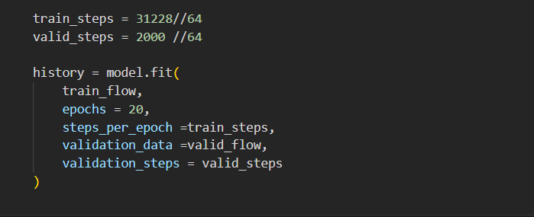
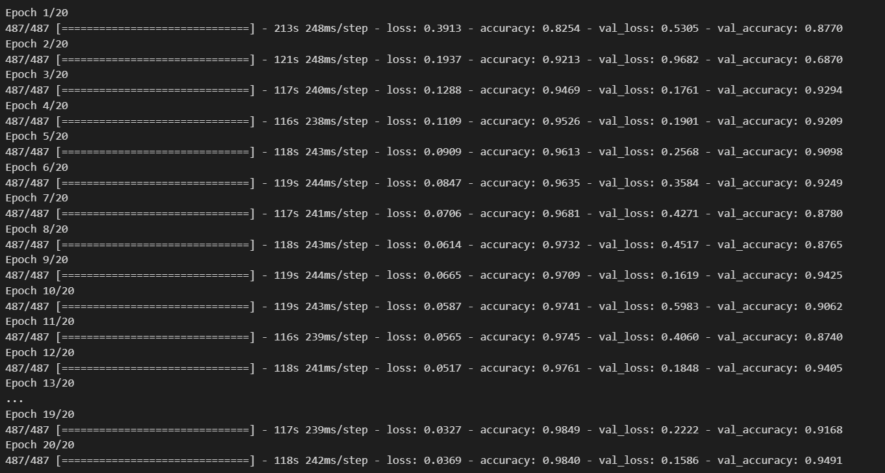
Video Detection
We train this model within 20 epochs. The final accuracy is 98% for training and 95% for validation.

Slide 26
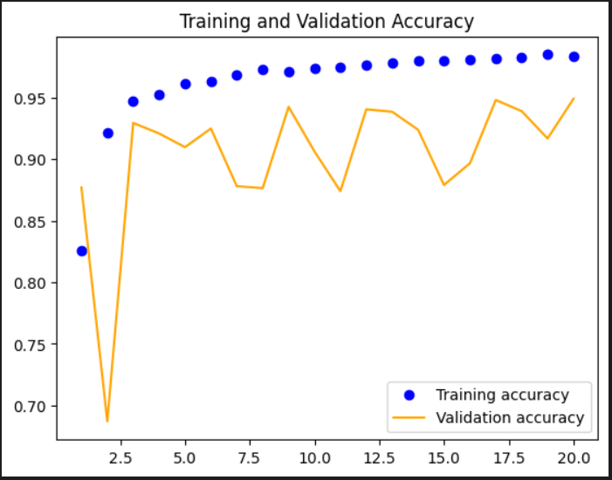
Video Detection

Slide 27
Survey

Slide 28
Image Models experiments
Model | Dataset splitting | # Epochs | Train Accuracy | Validation Accuracy | Test Accuracy
InceptionResentV2 | Train: 72% Validation: 14 % Test: 14 % | 10 | 93.2% | 89.6 % | 82%
InceptionResentV2 | Train: 72% Validation: 14 % Test: 14 % | 15 | 95.3 % | 92.1% | 87.4 %
Efficientnet | Train: 72% Validation: 14 % Test: 14 % | 10 | 85.7 % | 81.4% | 70 %
Efficientnet | Train: 72% Validation: 14 % Test: 14 % | 20 | 95.7 % | 88.7% | 80%
Densenet121 | Train: 72% Validation: 14 % Test: 14 % | 10 | 98.6 % | 95% | 93.7 %

Slide 29
Video Models experiments
Model | # Videos | # Epochs | Data Splitting | Running | Accuracy | Loss
Efficientnet | Real:100 Fake:100 | 10 | Training:80% Validation:20% | Kaggle | Training: 92.7% Validation: 88.3% | Training: 0.0251 Validation: 0.2111
Efficientnet | Real:400 Fake:400 | 15 | Training:80% Validation:20% | Kaggle | Training: 97.7% Validation: 89% | Training: 0.0092 Validation: 0.421
InceptionResnetV2 | Real:100 Fake:100 | 20 | Training:80% Validation:20% | Kaggle | Training:98% Validation:80% | Training: 0.1100 Validation: 0.6
InceptionResnetV2 | Real:900 Fake:900 | 6 | Training:80% Validation:20% | GPU lab | Training:99% Validation:90% | Training: 0.0088 Validation: 349
InceptionResnetV2 | Real:900 Fake:900 | 10 | Training:90% Validation:10% | GPU lab | Training:99% Validation:82% | Training: 0.0244 Validation: 1.127

Slide 30
Video Models experiments
Model | # Videos | # Epochs | Data Splitting | Running | Accuracy | Loss
InceptionResnetV2 | Real:900 Fake:900 | 20 | Training:80% Validation:20% | GPU lab | Training:98% Validation:80% | Training: 0.1 Validation: .6
InceptionResnetV2 With “image generator” | Real:900 Fake:900 | 20 | Training:70% Validation:30% | Kaggle | Training:98% Validation:95% | Training: 0.0369 Validation: .1586

Slide 31
Existing Solutions

Slide 32




Sensity Deepware Scanner
Microsoft Video Authenticator Deepfake-o-Meter

Slide 33
Testing

Slide 34
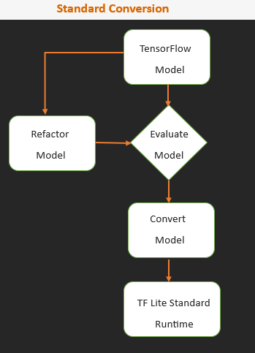
Conversion & Connection Architecture
Connection between Flutter app & TFLite model:
Load the tflite file of the model in the flutter app and add it to the app's assets folder.
Use the TFLite package to load the file and run the model in the flutter app.
Code loads the tflite file from the assets folder and run the model on the specified image or video.
The results are displayed in the UI as text.
Conversion Architecture

Slide 35
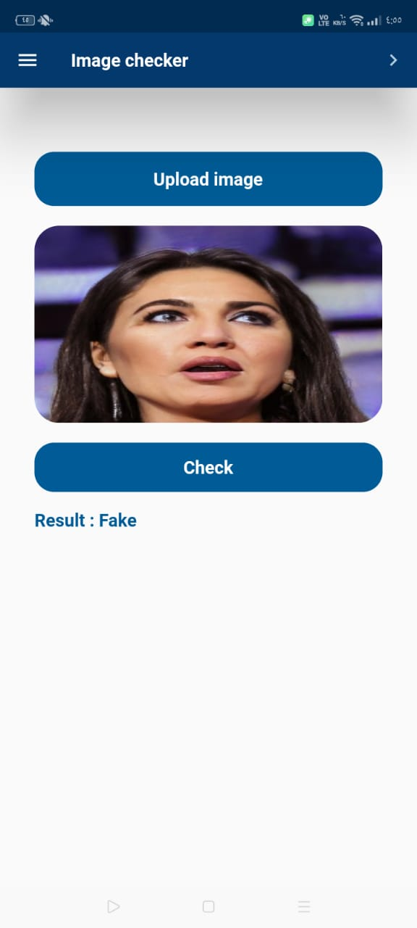
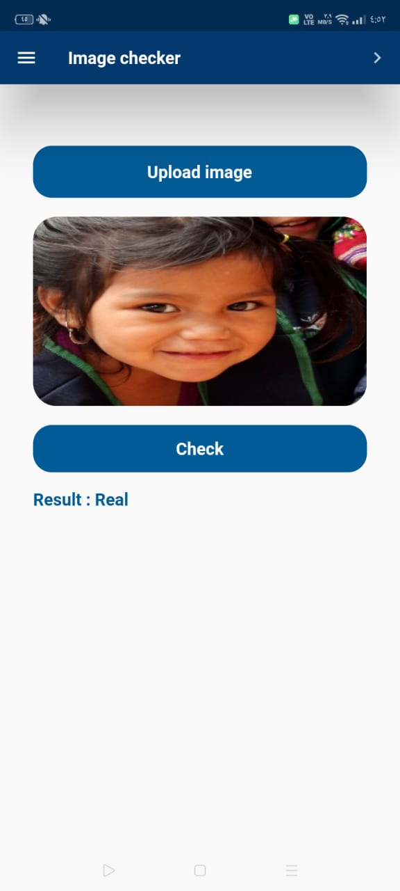
Image Testing

Slide 36
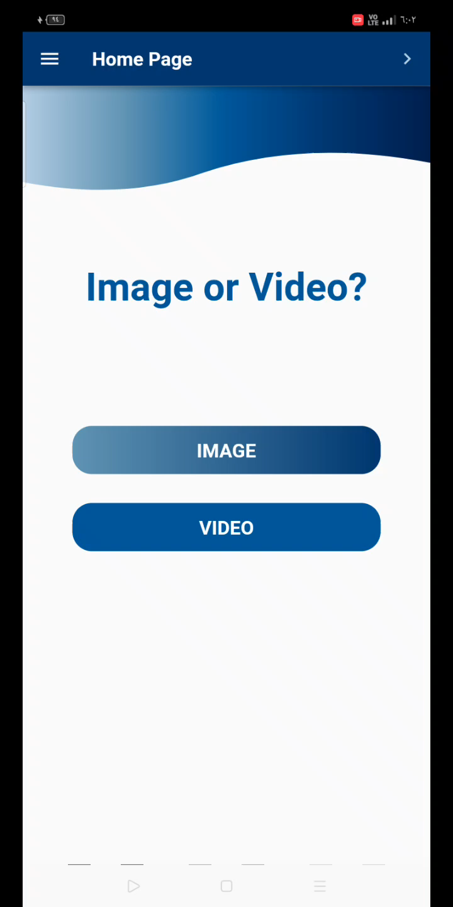

Video Testing

Slide 37
Future Work

Slide 38
We hope to spread this application among people about this problem (marketing) and make them aware, in addition to detecting other things that can be faked, such as audio, signatures, sales and purchase contracts, currencies and official papers.

Slide 39

Thanks
Contact us
Shrouq Kariman Mayar Ahmed Marwa

